Slide 1

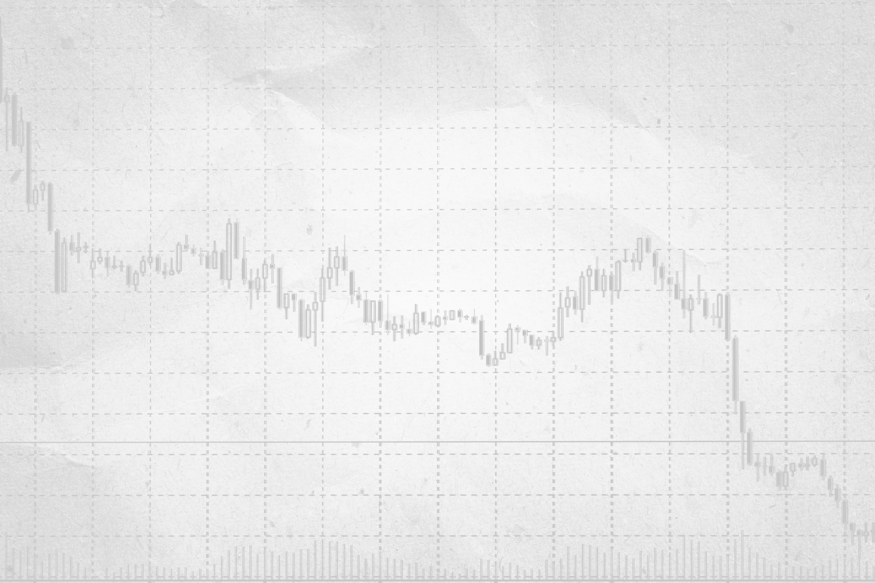

CP-302
Dynamic Time Warping
Project Advisor : Dr. Arun Kumar
Presented by :
Aditya Kumar Sahu
Akshit Singh

Slide 2
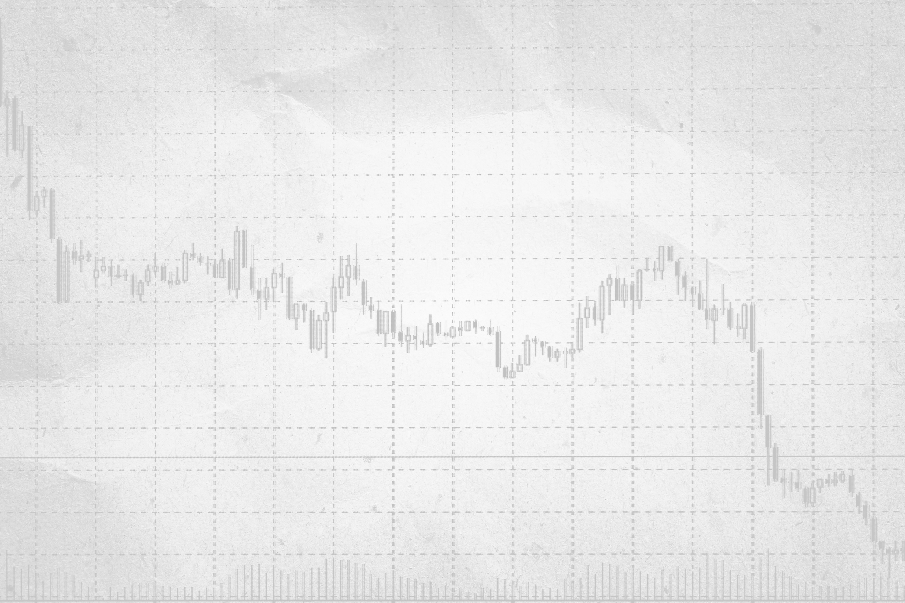
Introduction
TITLE
Pattern Matching Trading System Based on the Dynamic Time Warping Algorithm
Abstract
This project aims to identify stocks with similar trends to improve stock trend prediction. By using Dynamic Time Warping (DTW) to measure trend similarity and K-Nearest Neighbors (KNN) for classification, we match a stock's recent trend with the most similar historical trend from a pool of stocks. The matched stock's future trend is then used to predict the target stock's future behavior, aiding in more accurate trend forecasting.

Slide 3
Motivation
Importance of Identifying Similar Stock Trends
In stock trend analysis, identifying stocks with similar trends is fundamental for improving the accuracy of market predictions. Stocks that follow parallel paths in their historical performance are likely to exhibit similar behavior in the future. By recognizing these patterns, we can better anticipate market movements and make more informed investment decisions.
Predicting Future Stock Movements
If we aim to predict the future trend of a specific stock, such as stock A, we can analyze its past three months of performance and search for a similar historical trend from a pool of stocks. If we identify stock B as having a closely matching trend, we can leverage B’s historical data to forecast stock A’s future movements. This approach offers a practical and data-driven method for improving stock prediction accuracy.

Slide 4
Motivation
Influence of Industry and Market Conditions
Stocks are heavily influenced by various factors, such as industry trends, economic conditions, and market sentiment. For instance, companies like Apple and Microsoft, both operating in the technology sector, may demonstrate similar stock trends due to shared market influences. Recognizing these industry-specific patterns is key to understanding broader market dynamics and how external conditions affect stock movements.
Enhancing Portfolio Diversification and Risk Management
Identifying stocks with parallel trends can also serve as a powerful tool for portfolio diversification and risk management. Investors can balance their portfolios by including stocks that move similarly, enabling them to hedge risks more effectively. Understanding how stocks behave in relation to one another helps in minimizing potential losses while maximizing the potential for gains.

Slide 5
Introduction to Dynamic Time Warping (DTW)
Dynamic Time Warping (DTW) is a way to compare two -usually temporal- sequences that do not sync up perfectly. It is a method to calculate the optimal matching between two sequences.
DTW is useful in many domains such as
speech recognition,
time series averaging,
financial markets, etc.
It’s commonly used in data mining to measure the distance between two time-series.

Slide 6
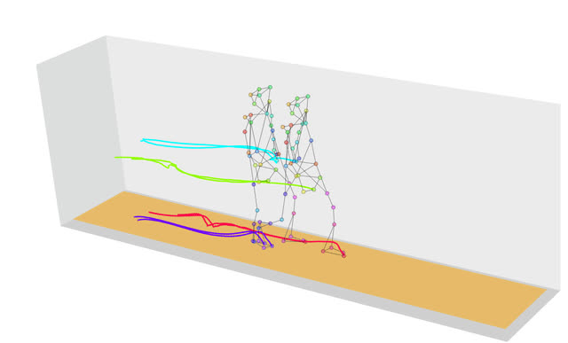

Slide 7
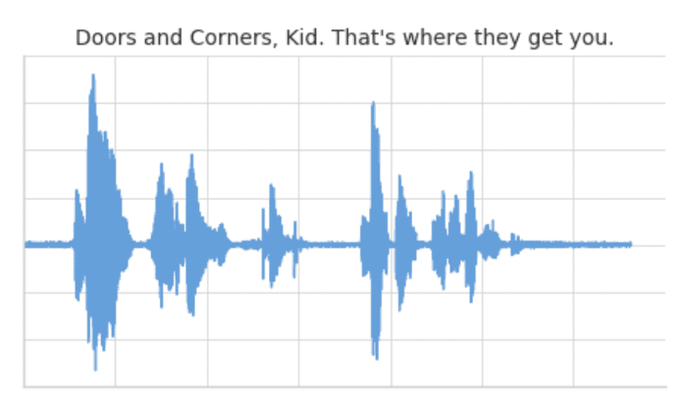
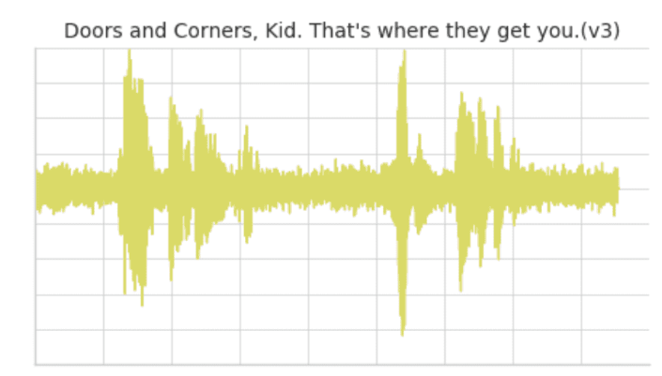
Sound Pattern Matching Using DTW
Clip 1: This is our base time series based on the quote “Doors and corners, kid. That's where they get you”.
Clip 2: This is a new time series based on clip 1 where the intonation and speech pattern is similar to clip 1.
CLIP-1
CLIP-2

Slide 8
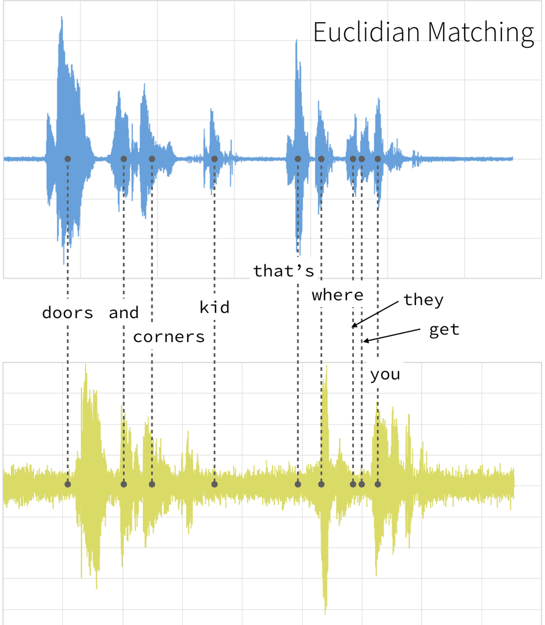
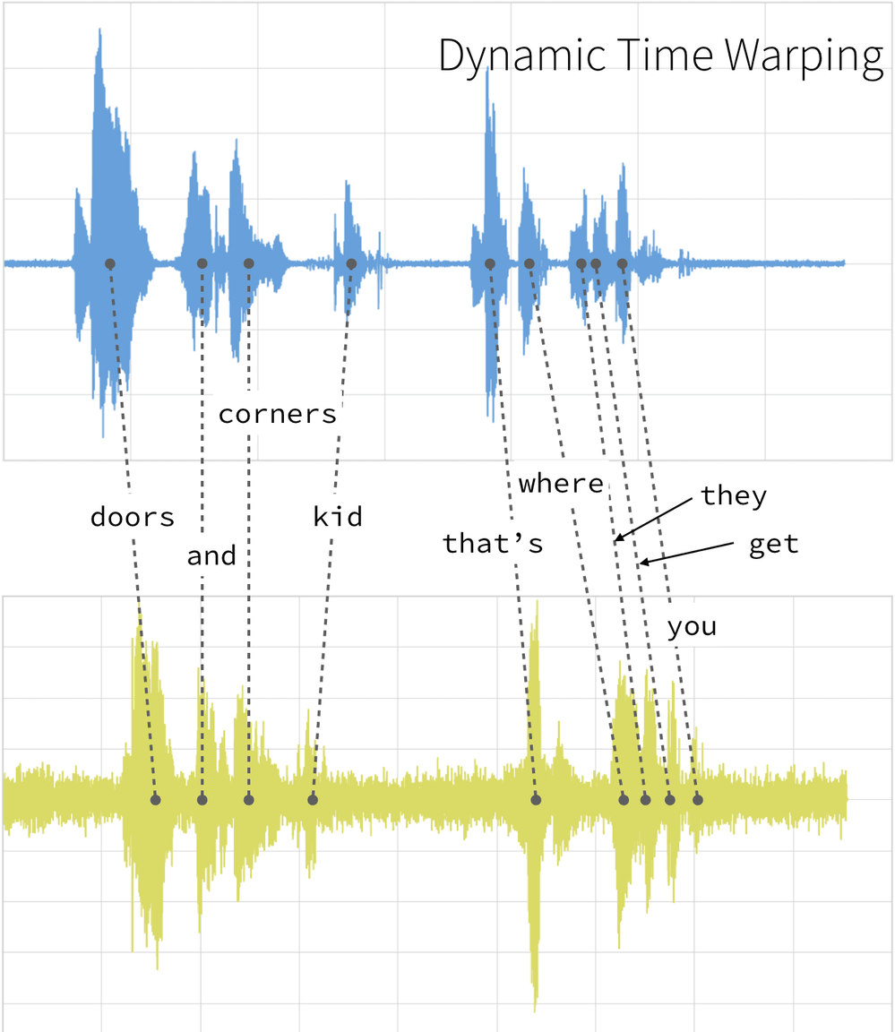

Slide 9
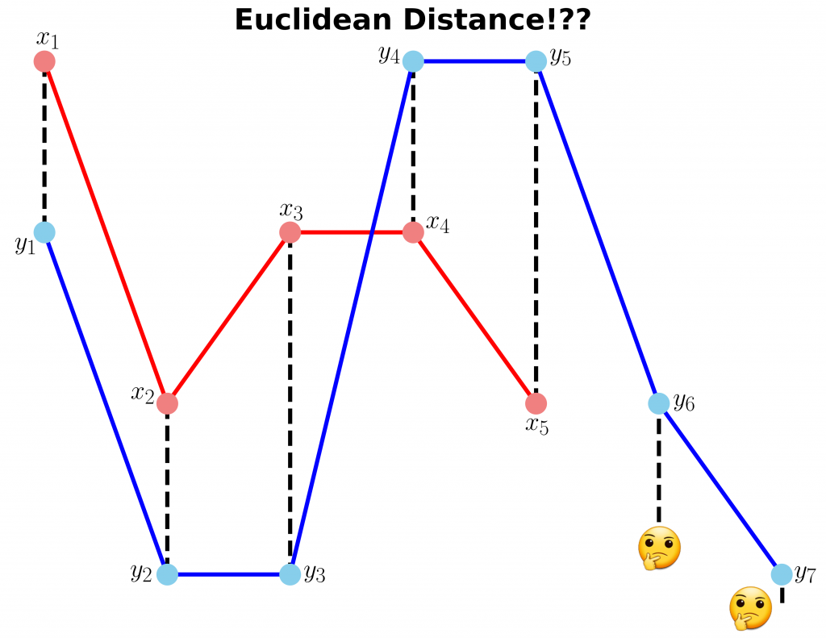
Suppose :
X =[3, 1, 2, 2, 1]
Y = [2, 0, 0, 3, 3, 1, 0]

Slide 10
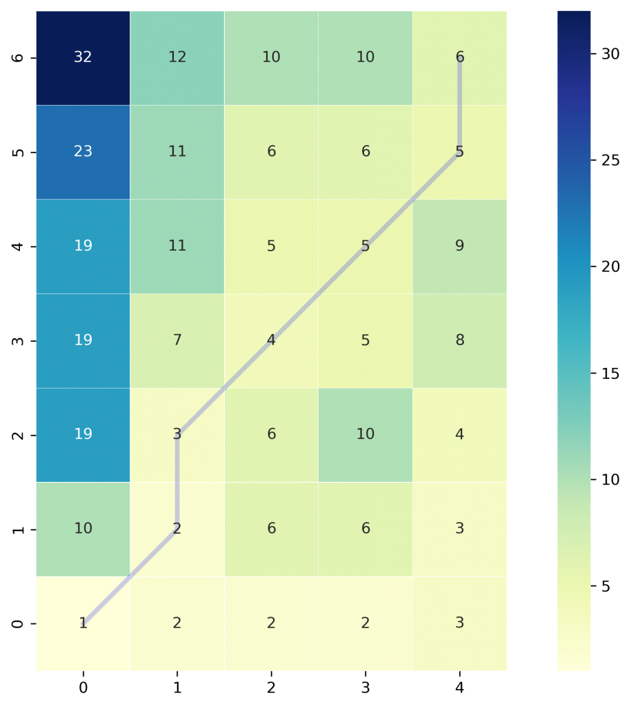

Slide 11
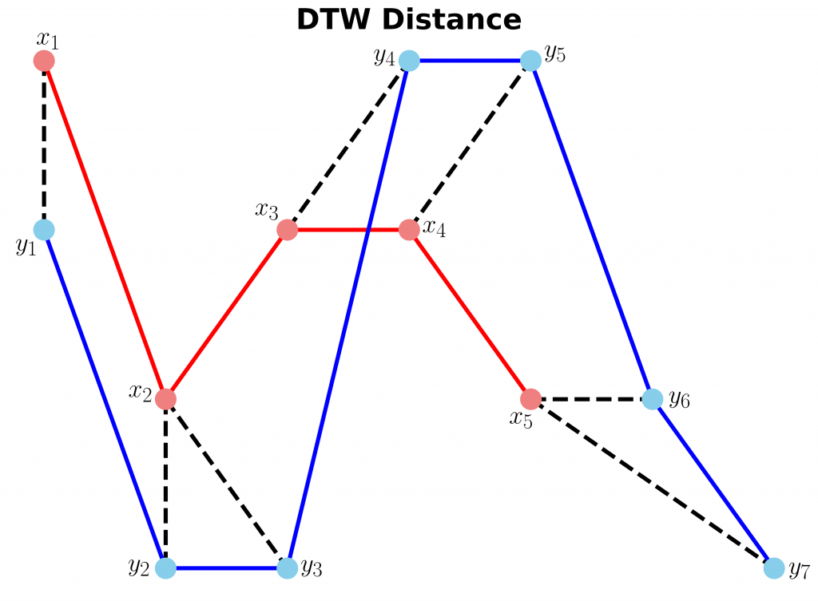

Slide 12
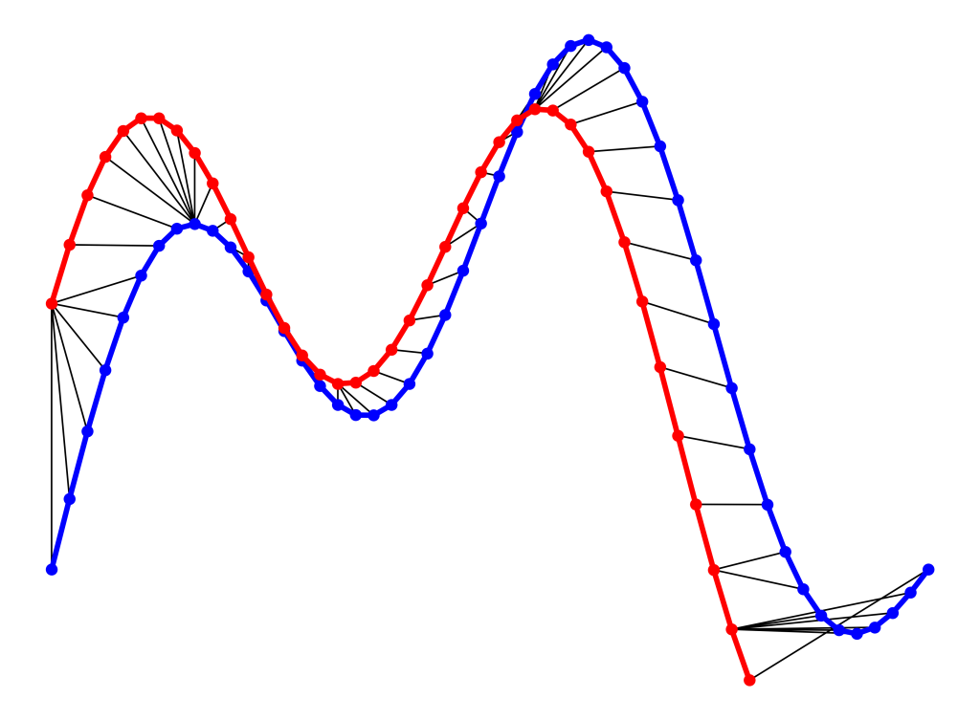

Slide 13
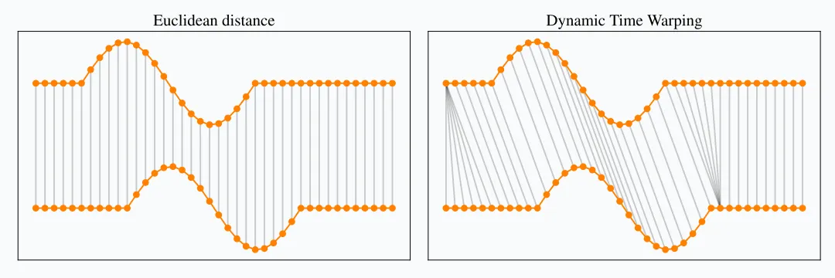

Slide 14
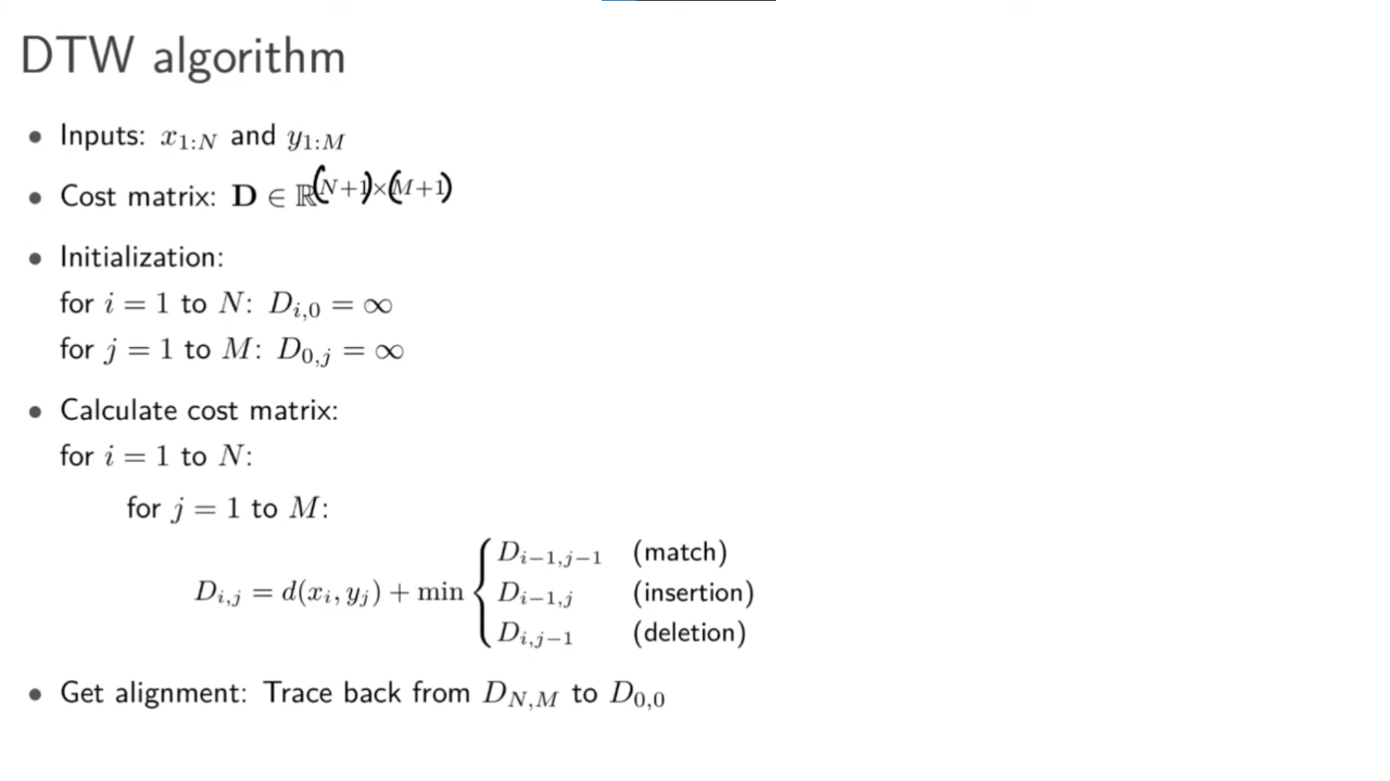

Slide 15
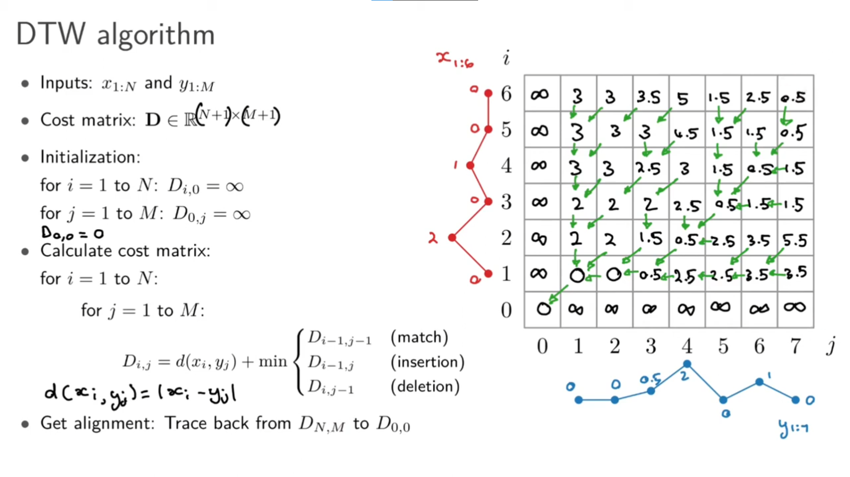

Slide 16
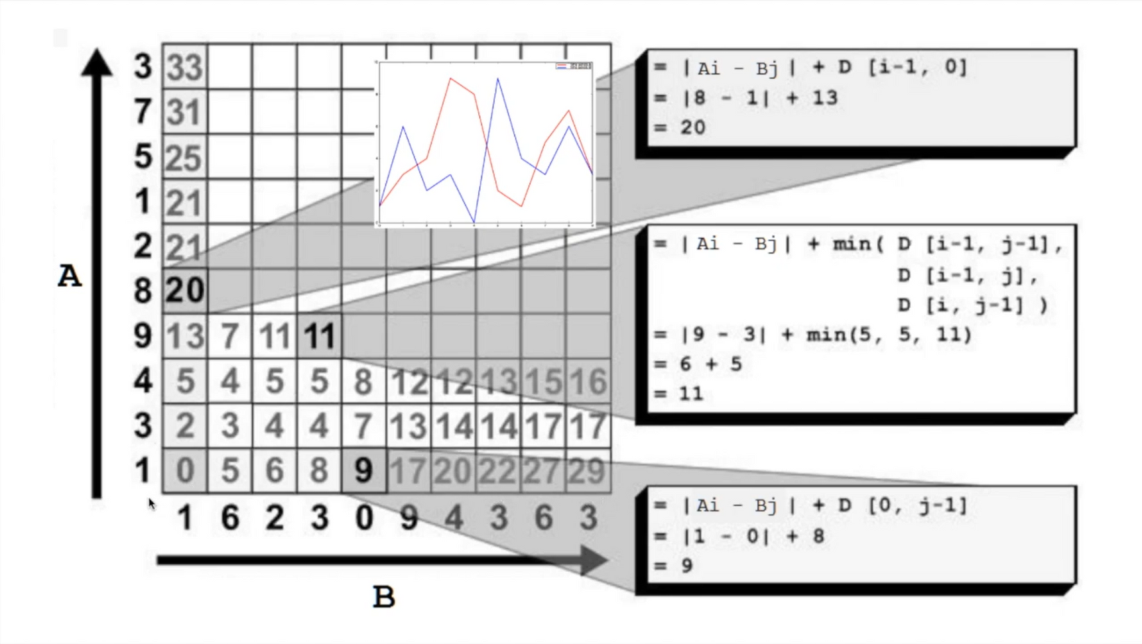

Slide 17
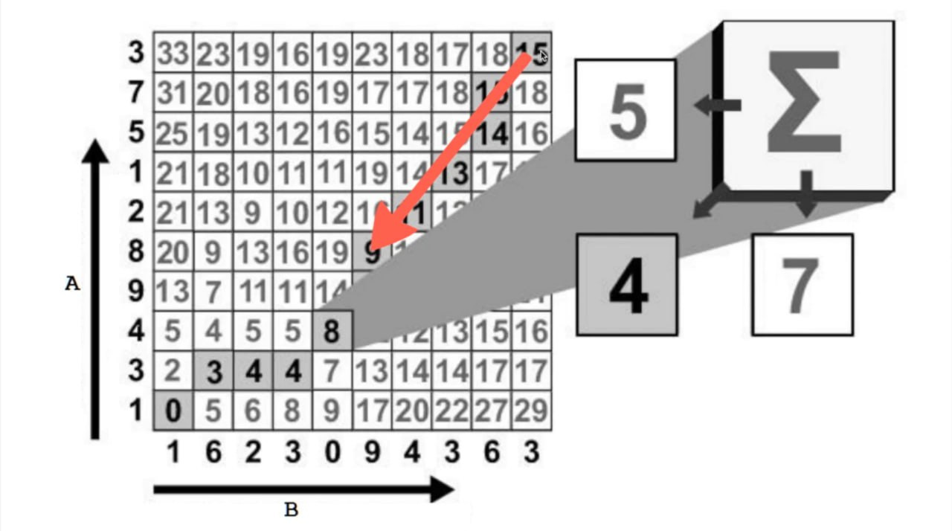

Slide 18
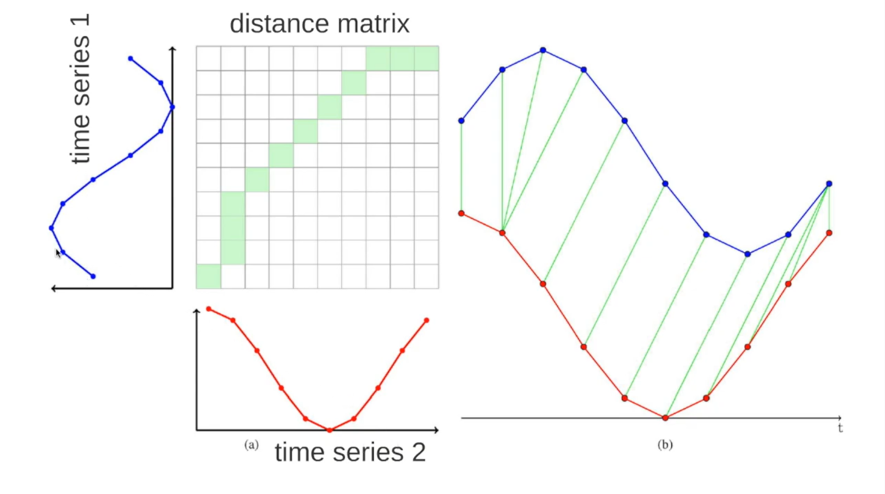

Slide 19
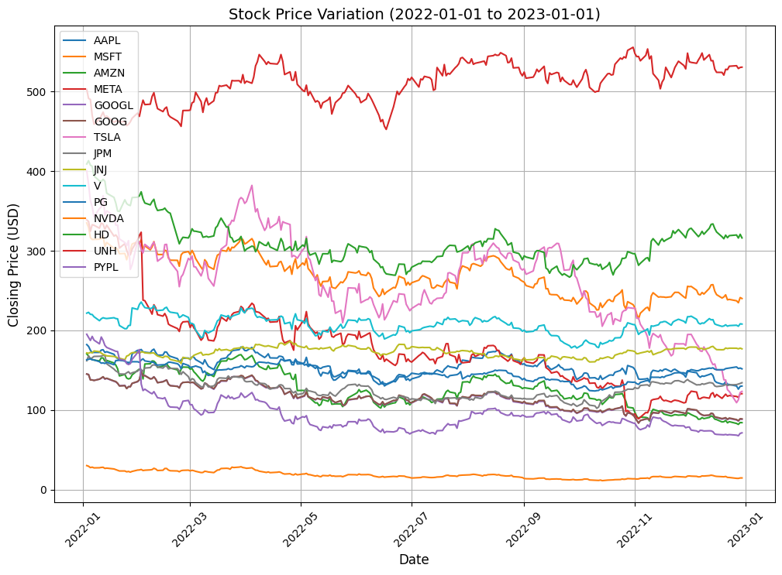
DTW on Same length of Stocks
First we took input of 15 stocks and plotted their stock prices for last 1 year
Companies involved :
Apple
Microsoft
Amazon
Meta
Google
JPMC
Tesla
Nvidia
Paypal
etc

Slide 20
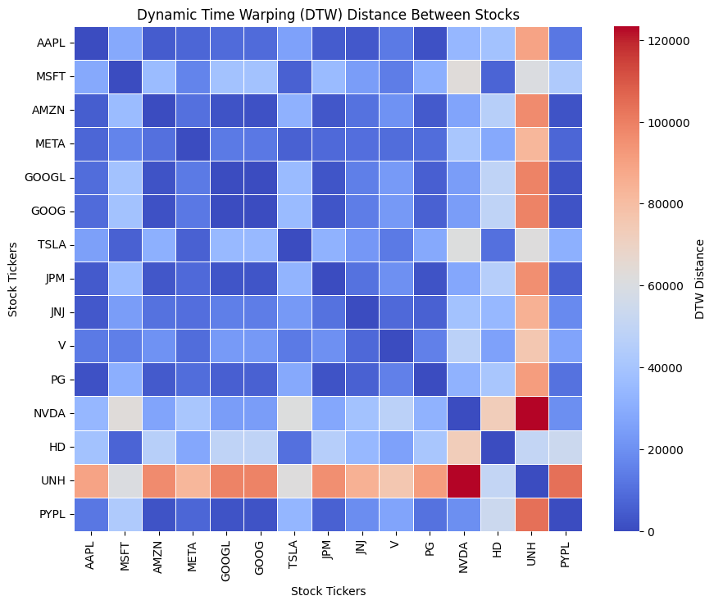
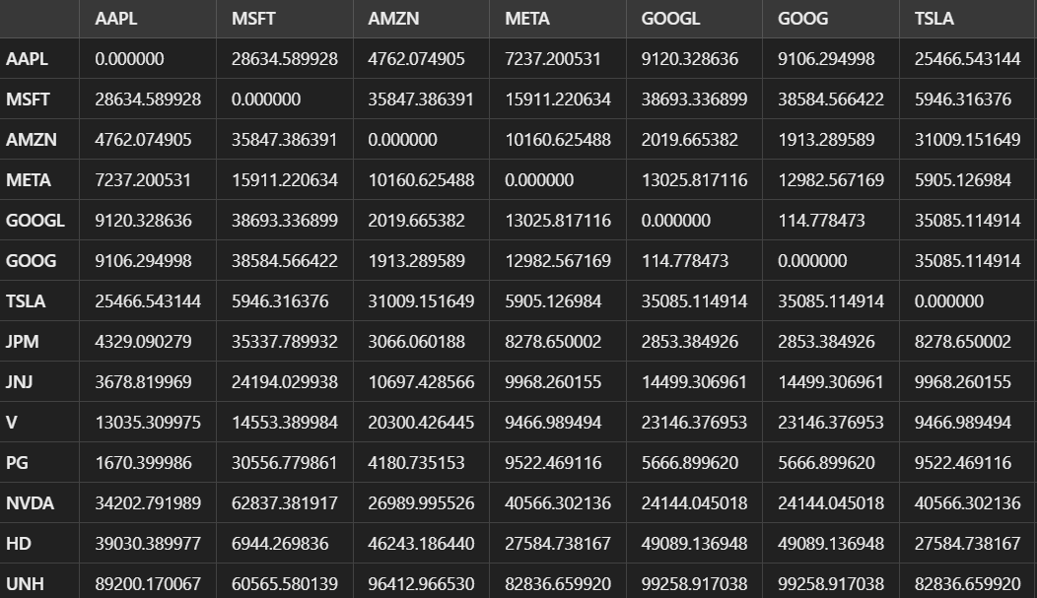
DTW on Same length of Stocks
Implemented DTW on all the stocks for finding similarities.

Slide 21
DTW on Same length of Stocks
We found the stocks with the most similar trend and paired them with each other.
Result obtained
AAPL's closest neighbour is PG with a similarity score of 1692.610008239746.
MSFT's closest neighbour is TSLA with a similarity score of 5961.919708251953.
AMZN's closest neighbour is GOOG with a similarity score of 1904.8935852050781.
META's closest neighbour is TSLA with a similarity score of 5929.91032409668.
GOOGL's closest neighbour is GOOG with a similarity score of 114.77847290039062.
GOOG's closest neighbour is GOOGL with a similarity score of 114.77847290039062.
TSLA's closest neighbour is META with a similarity score of 5905.126983642578.
JPM's closest neighbour is PG with a similarity score of 1971.1000518798828.
JNJ's closest neighbour is AAPL with a similarity score of 3678.819969177246.
V's closest neighbour is JNJ with a similarity score of 8133.600006103516.
PG's closest neighbour is AAPL with a similarity score of 1670.3999862670898.
NVDA's closest neighbour is PYPL with a similarity score of 19686.422108650208.
HD's closest neighbour is MSFT with a similarity score of 6944.269836425781.
UNH's closest neighbour is HD with a similarity score of 50169.78009033203.
PYPL's closest neighbour is GOOGL with a similarity score of 2227.4922943115234.

Slide 22
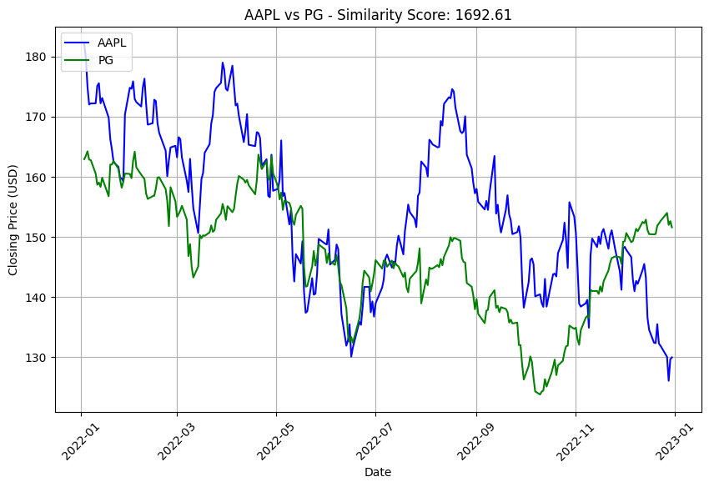

Slide 23
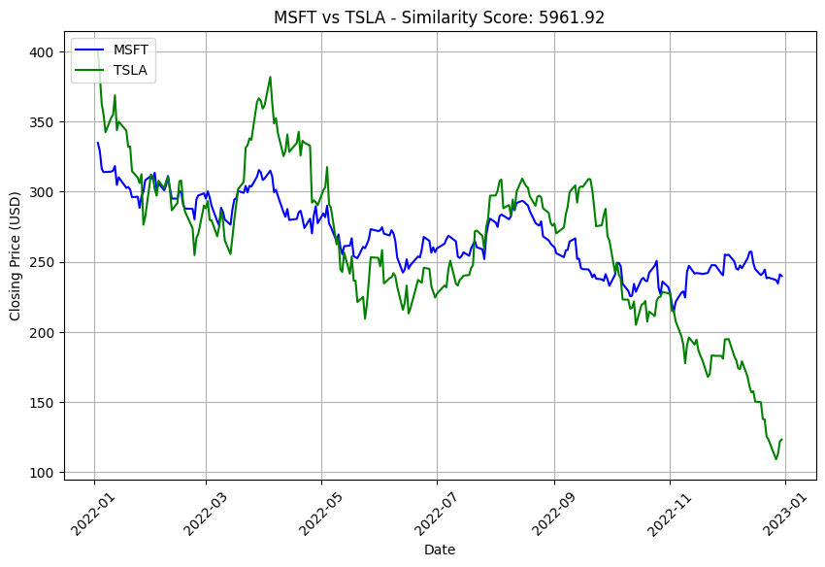

Slide 24
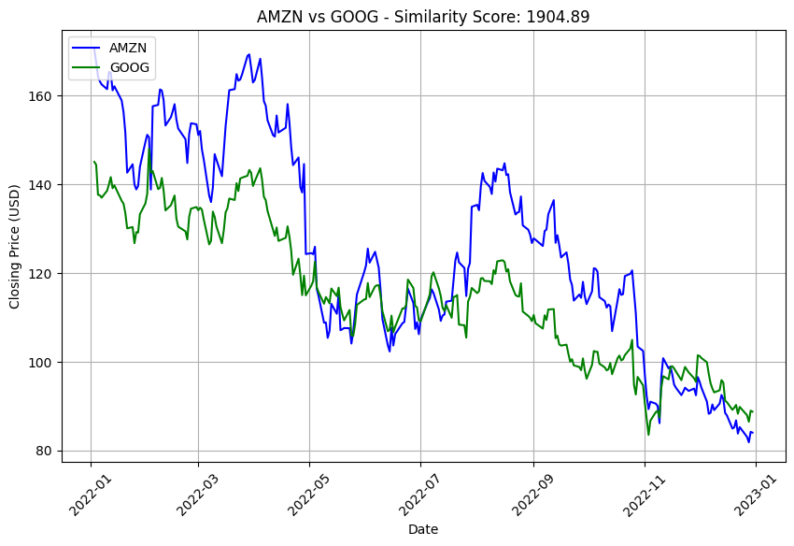

Slide 25
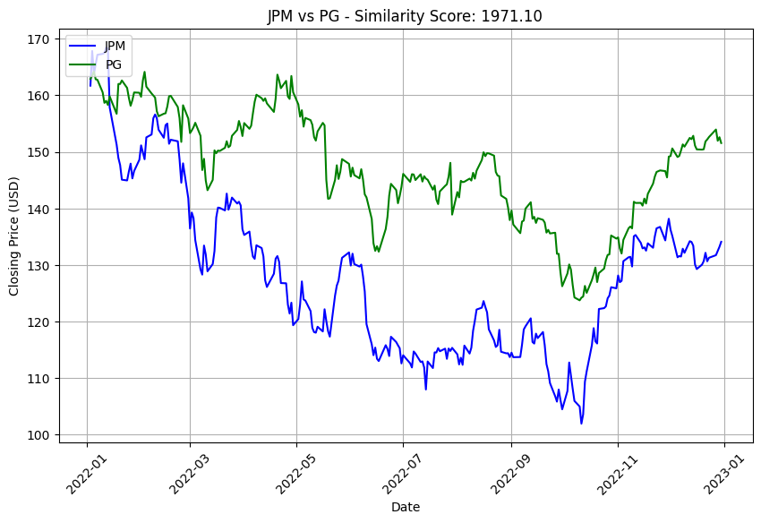

Slide 26
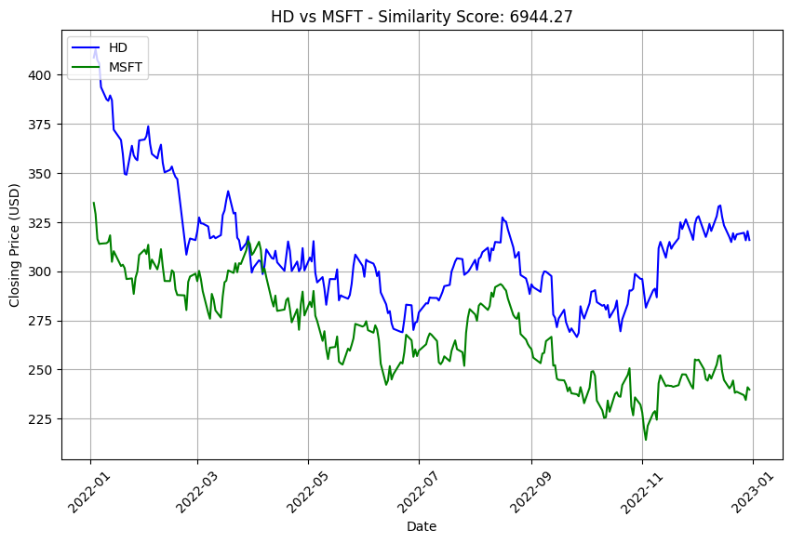

Slide 27
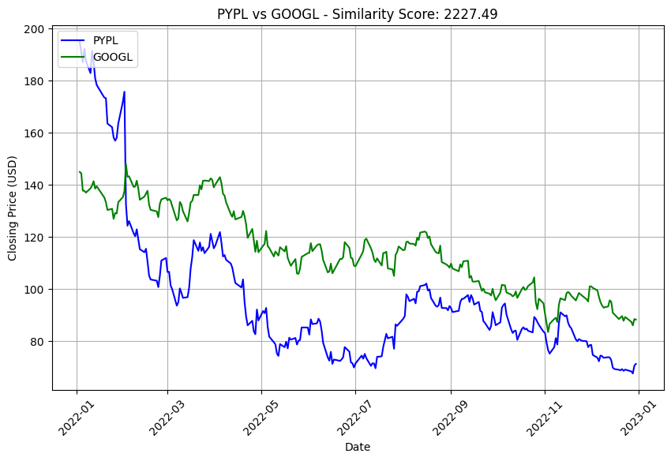

Slide 28
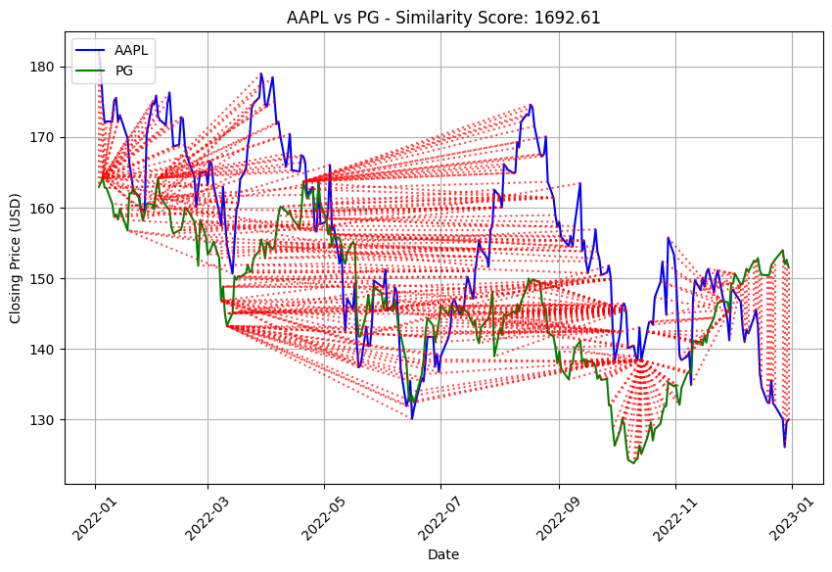
On what points these stocks were equal?

Slide 29
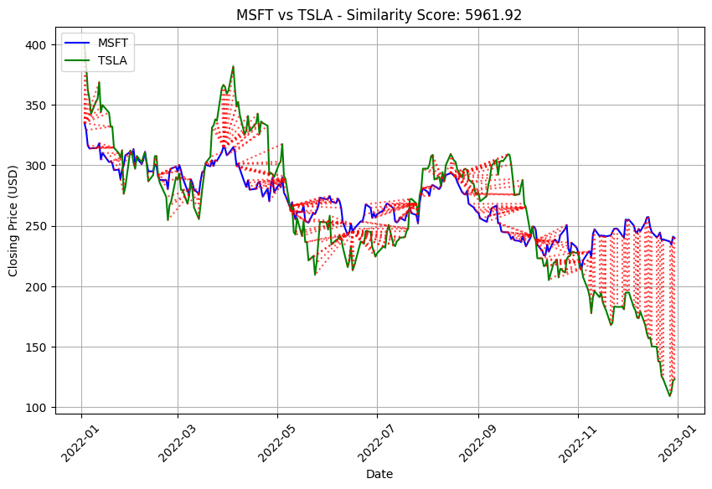
On what points these stocks were equal?

Slide 30
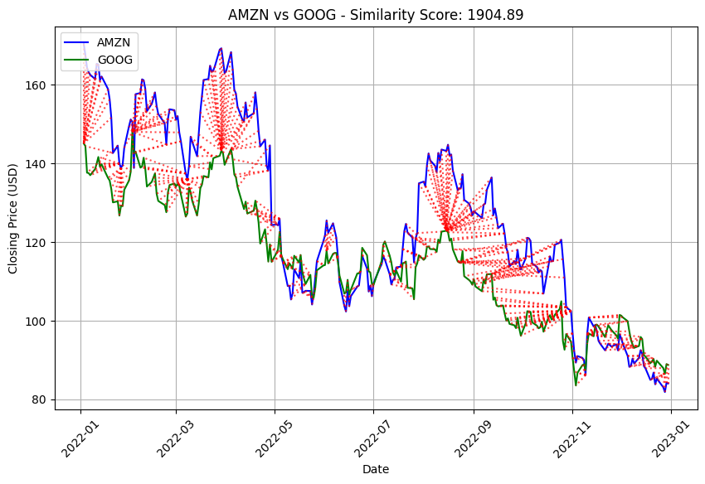
On what points these stocks were equal?

Slide 31
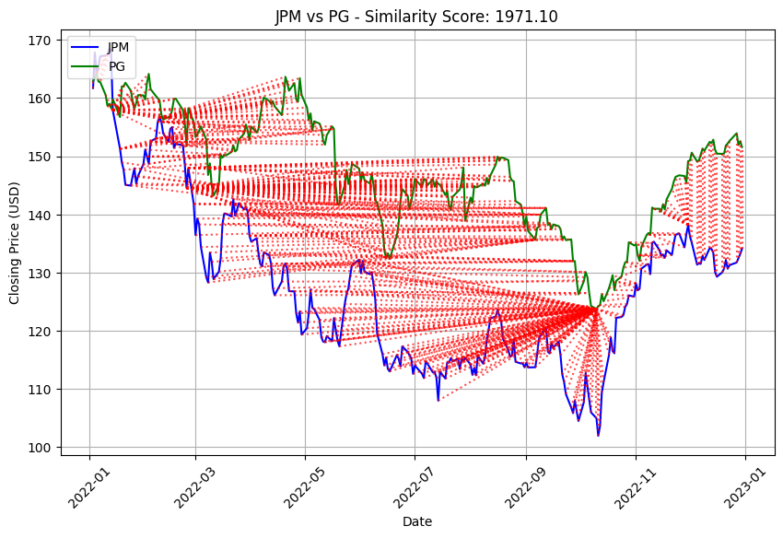
On what points these stocks were equal?

Slide 32
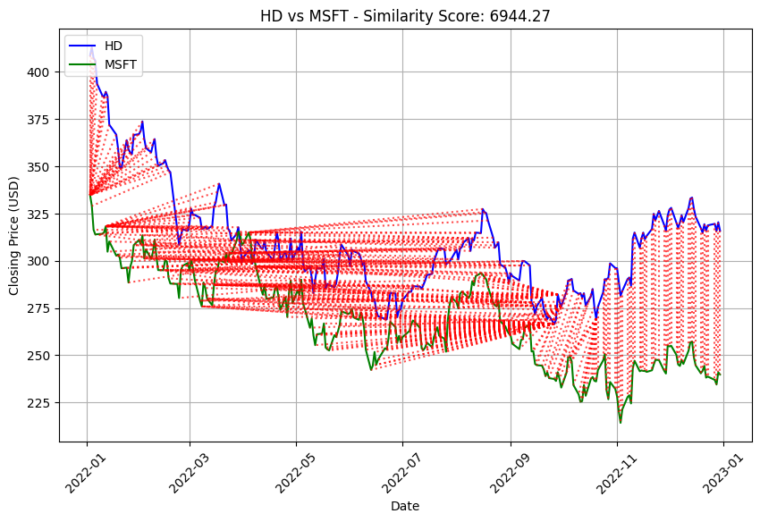
On what points these stocks were equal?

Slide 33
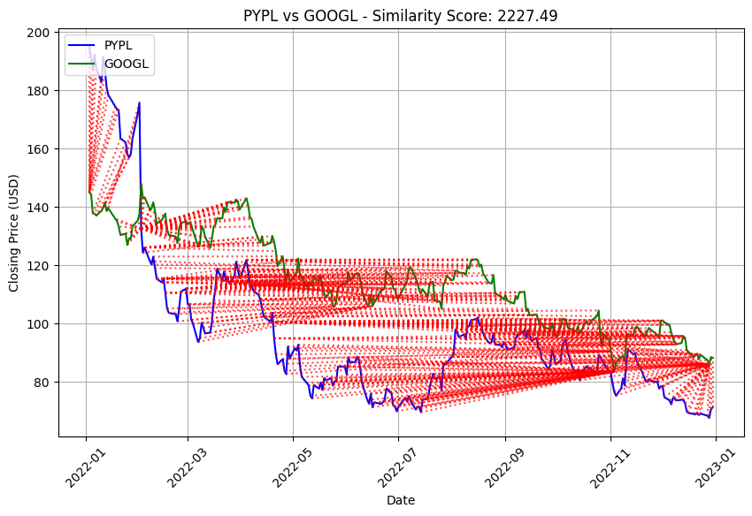
On what points these stocks were equal?

Slide 34
What’s Next
1. Given a graph/stock, we will tell you which graph/stocks suits the best of the various companies listed on NASDAQ Index.
2. Evaluate this trading strategy and analyse the efficiency.
3. Evaluating the results and will try to implement it on High Frequency Data.
4. Using CNN, enhance the capabilities of the 1 point.

